Slide 1
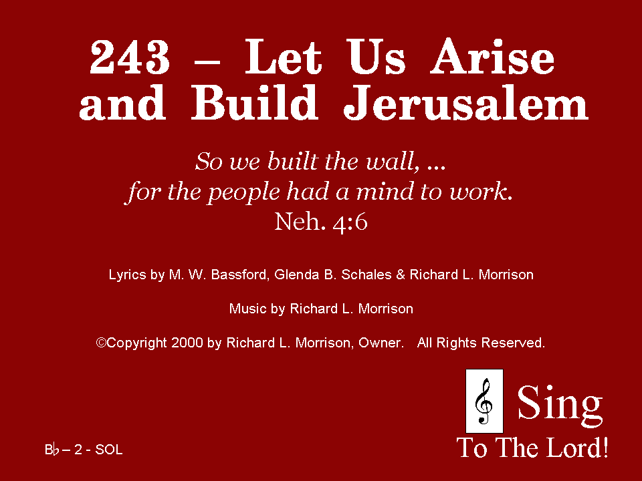
243 - Let Us Arise And Build Jerusalem - Title

Slide 2
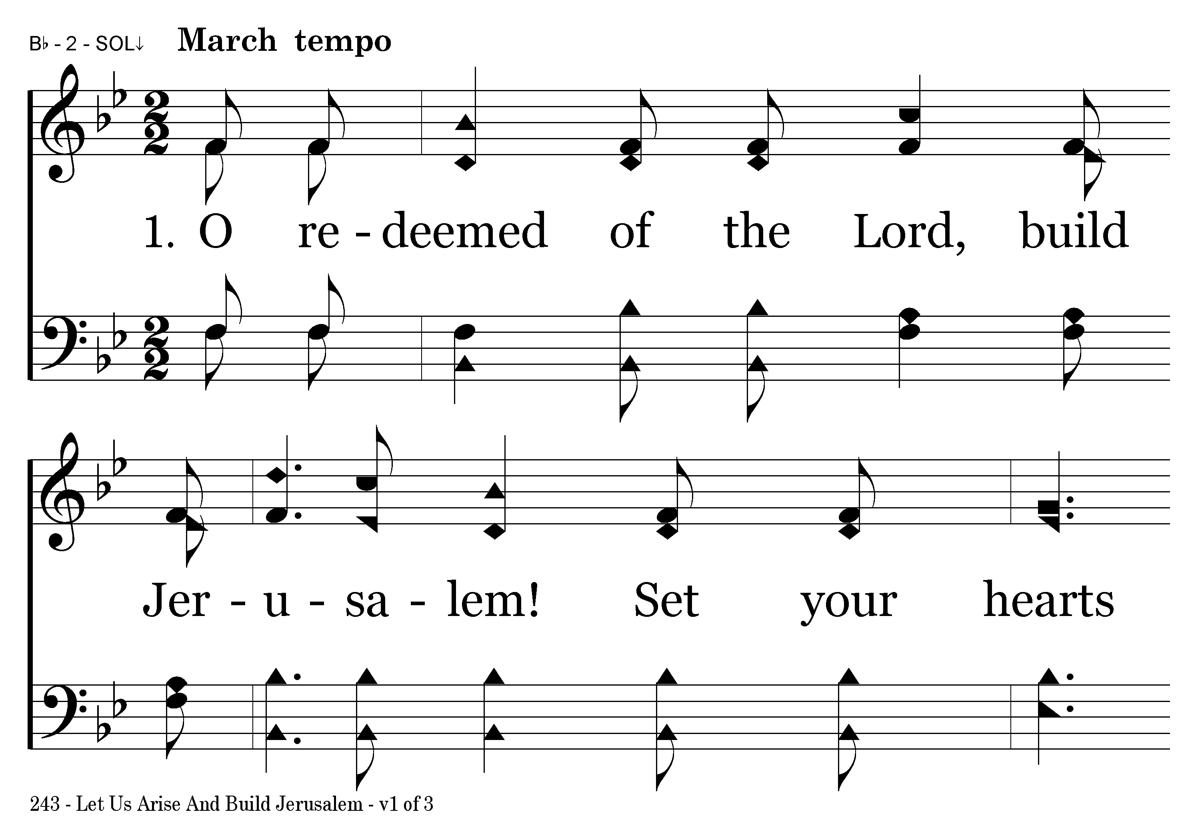
243 - Let Us Arise And Build Jerusalem - 1.1

Slide 3
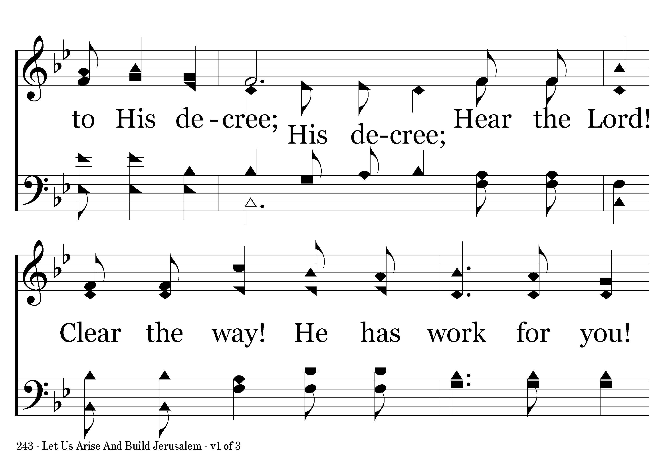
243 - Let Us Arise And Build Jerusalem - 1.2

Slide 4
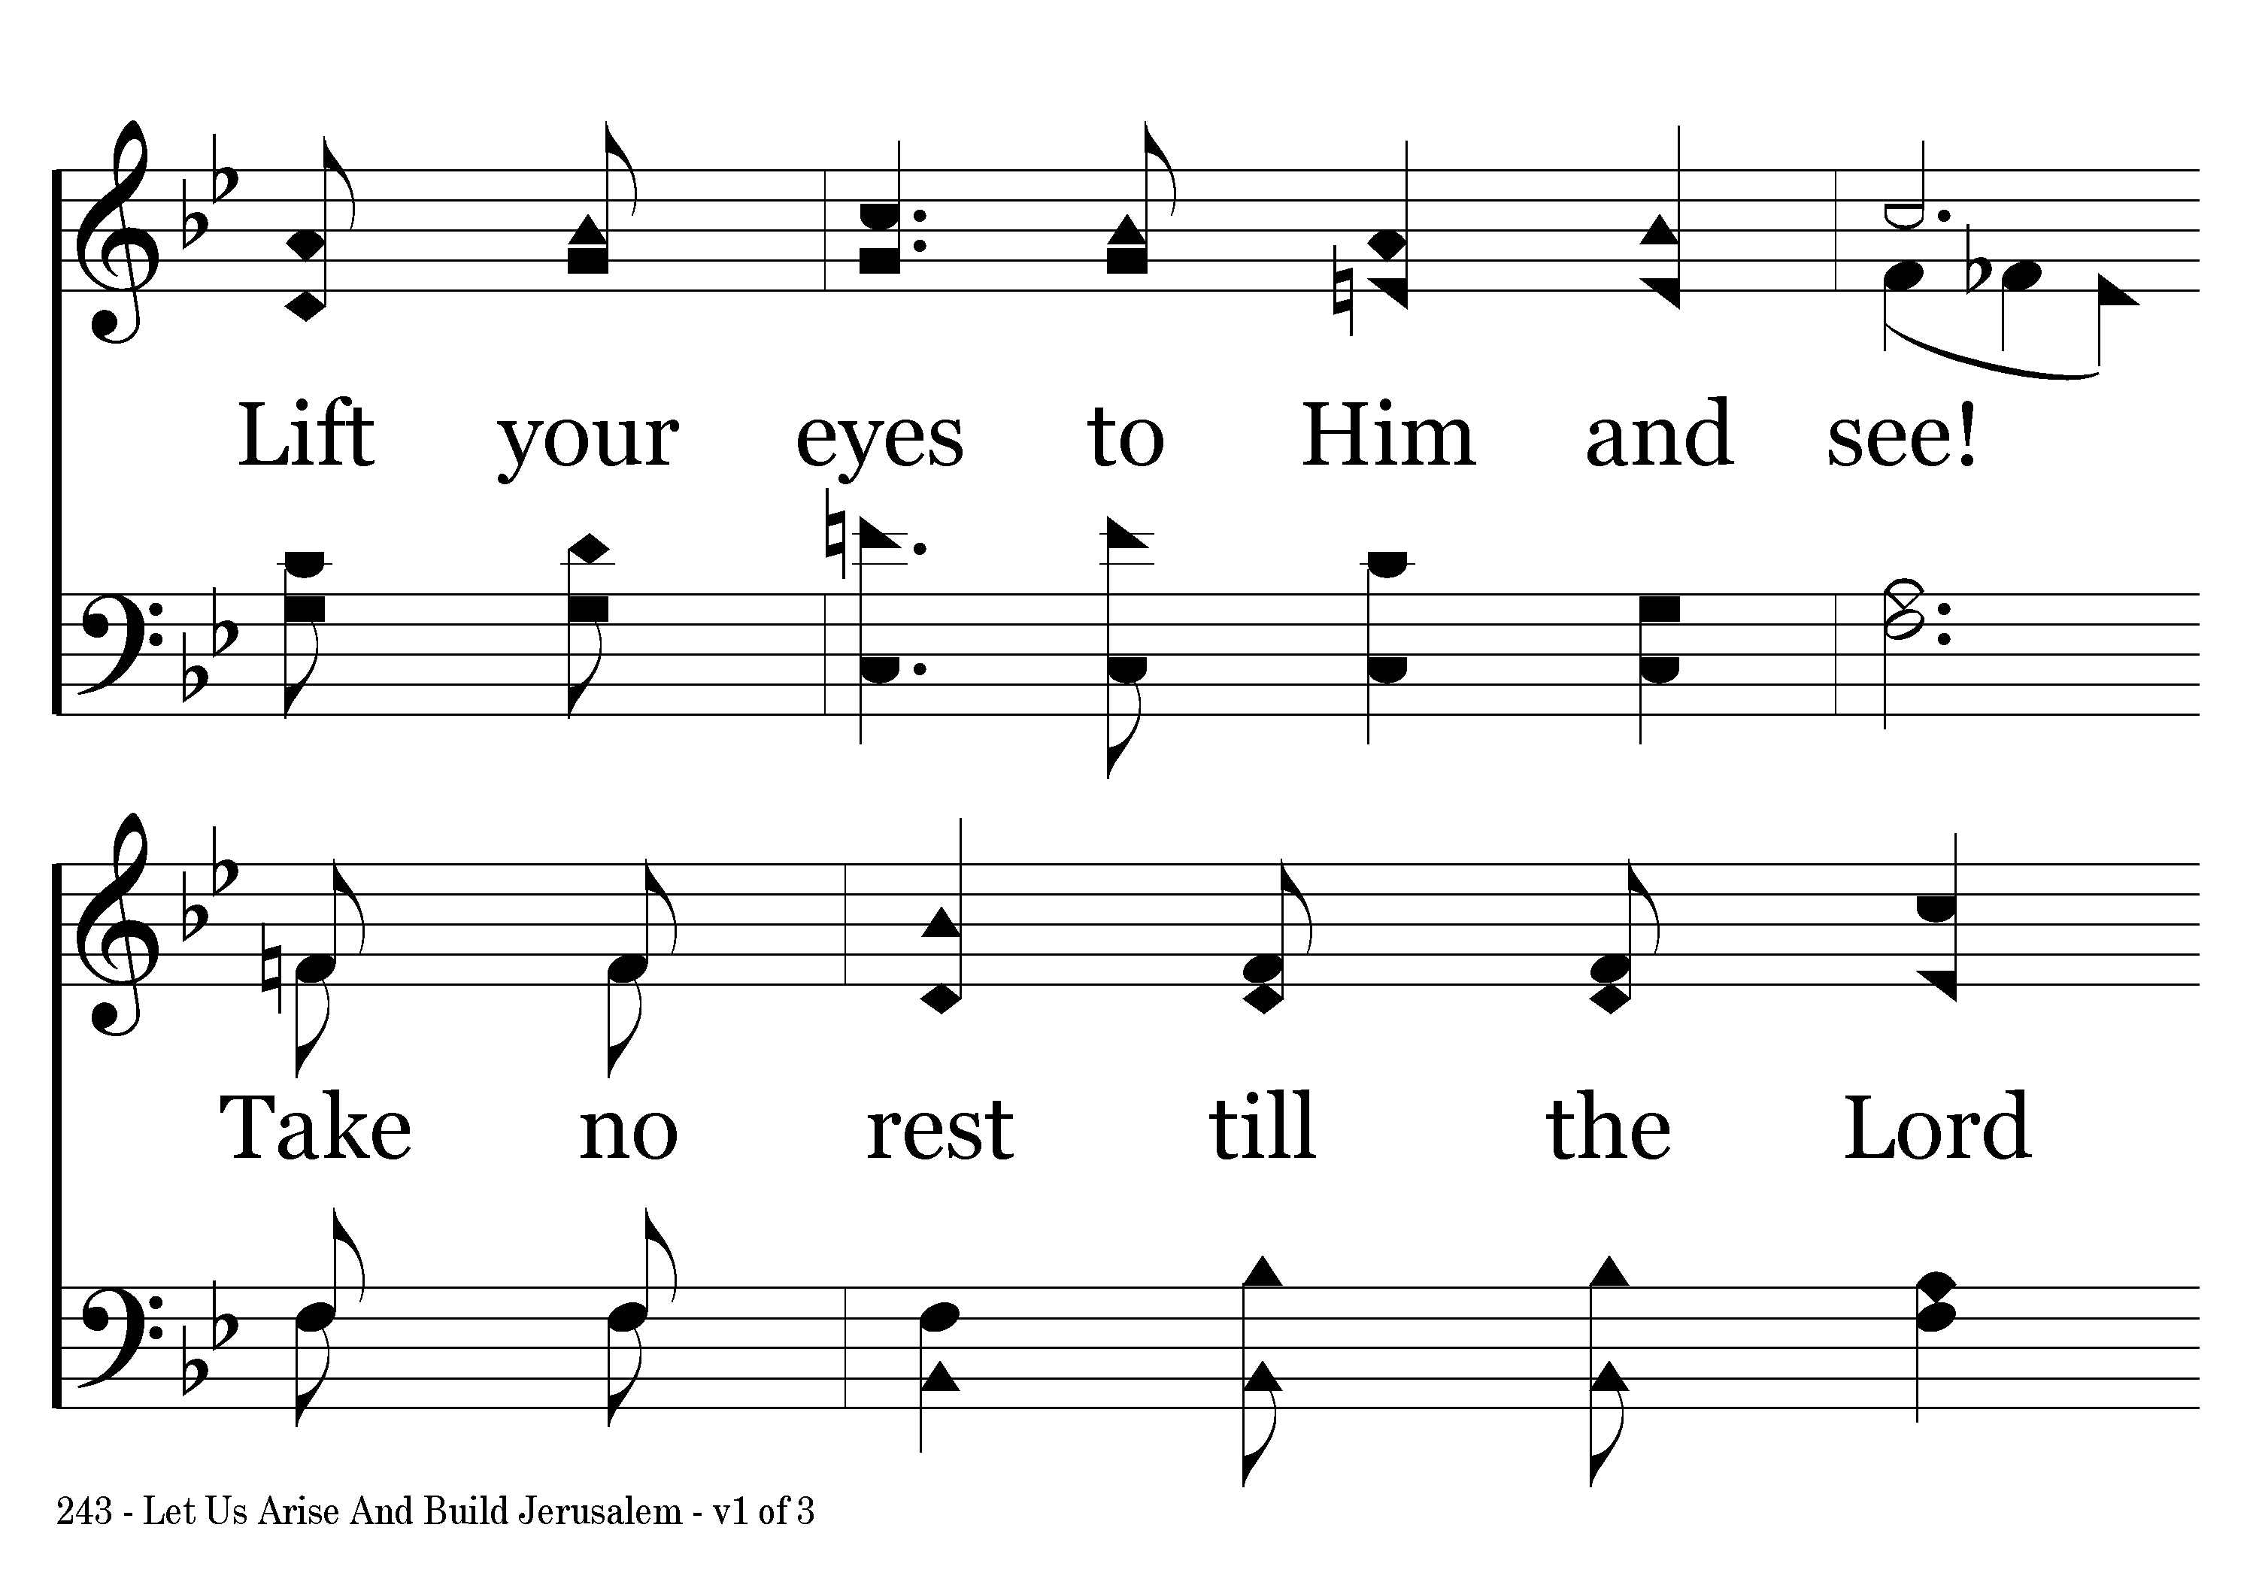
243 - Let Us Arise And Build Jerusalem - 1.3

Slide 5
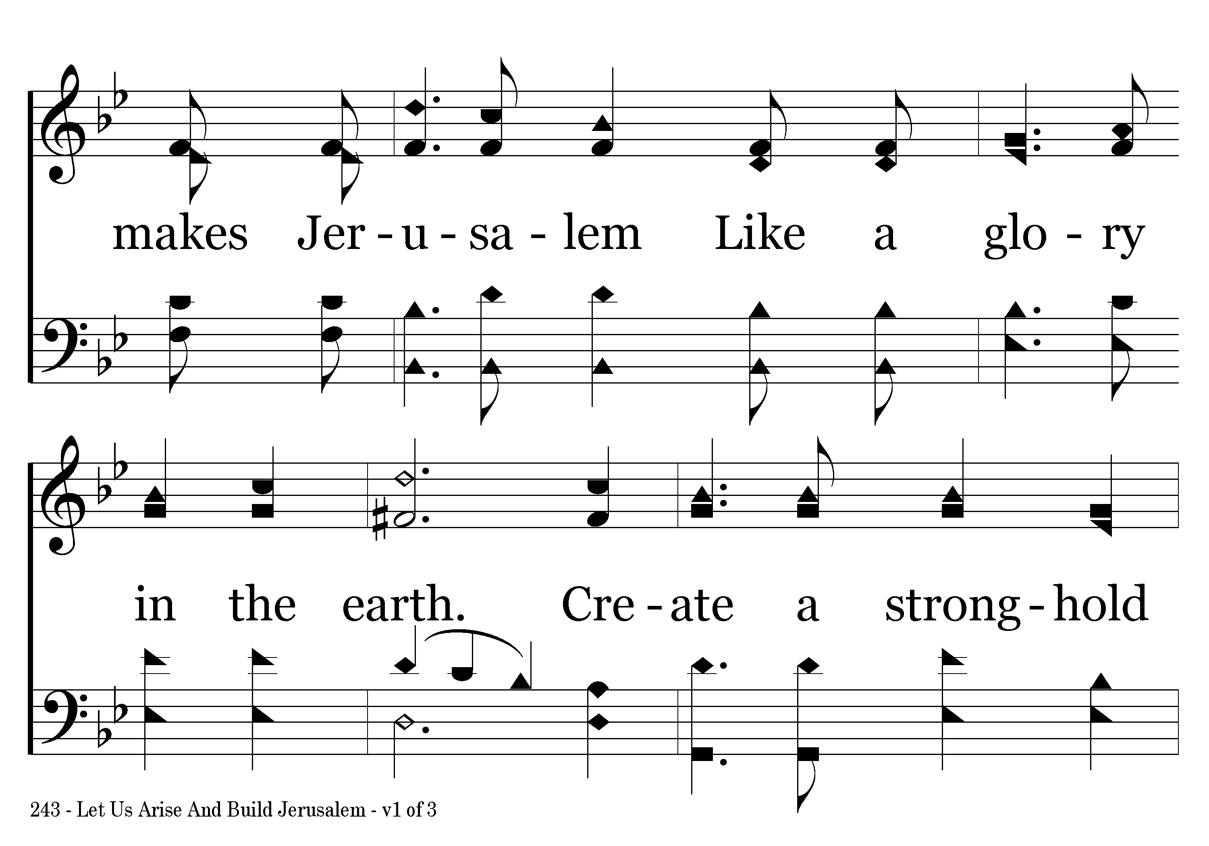
243 - Let Us Arise And Build Jerusalem - 1.4

Slide 6
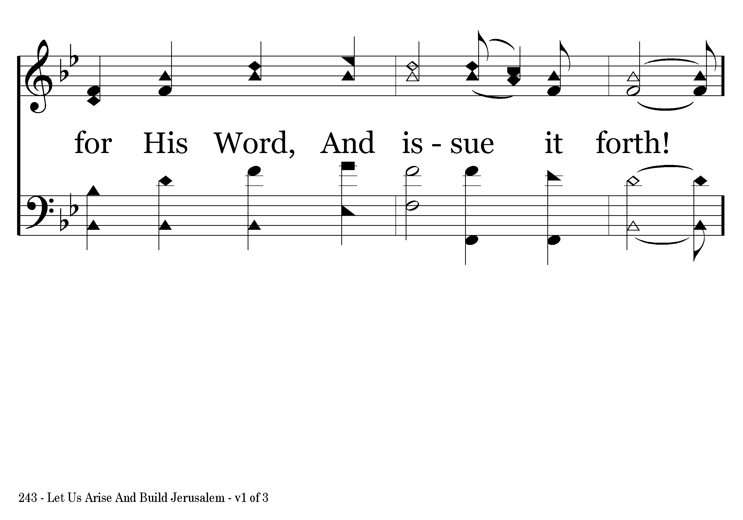
243 - Let Us Arise And Build Jerusalem - 1.5

Slide 7
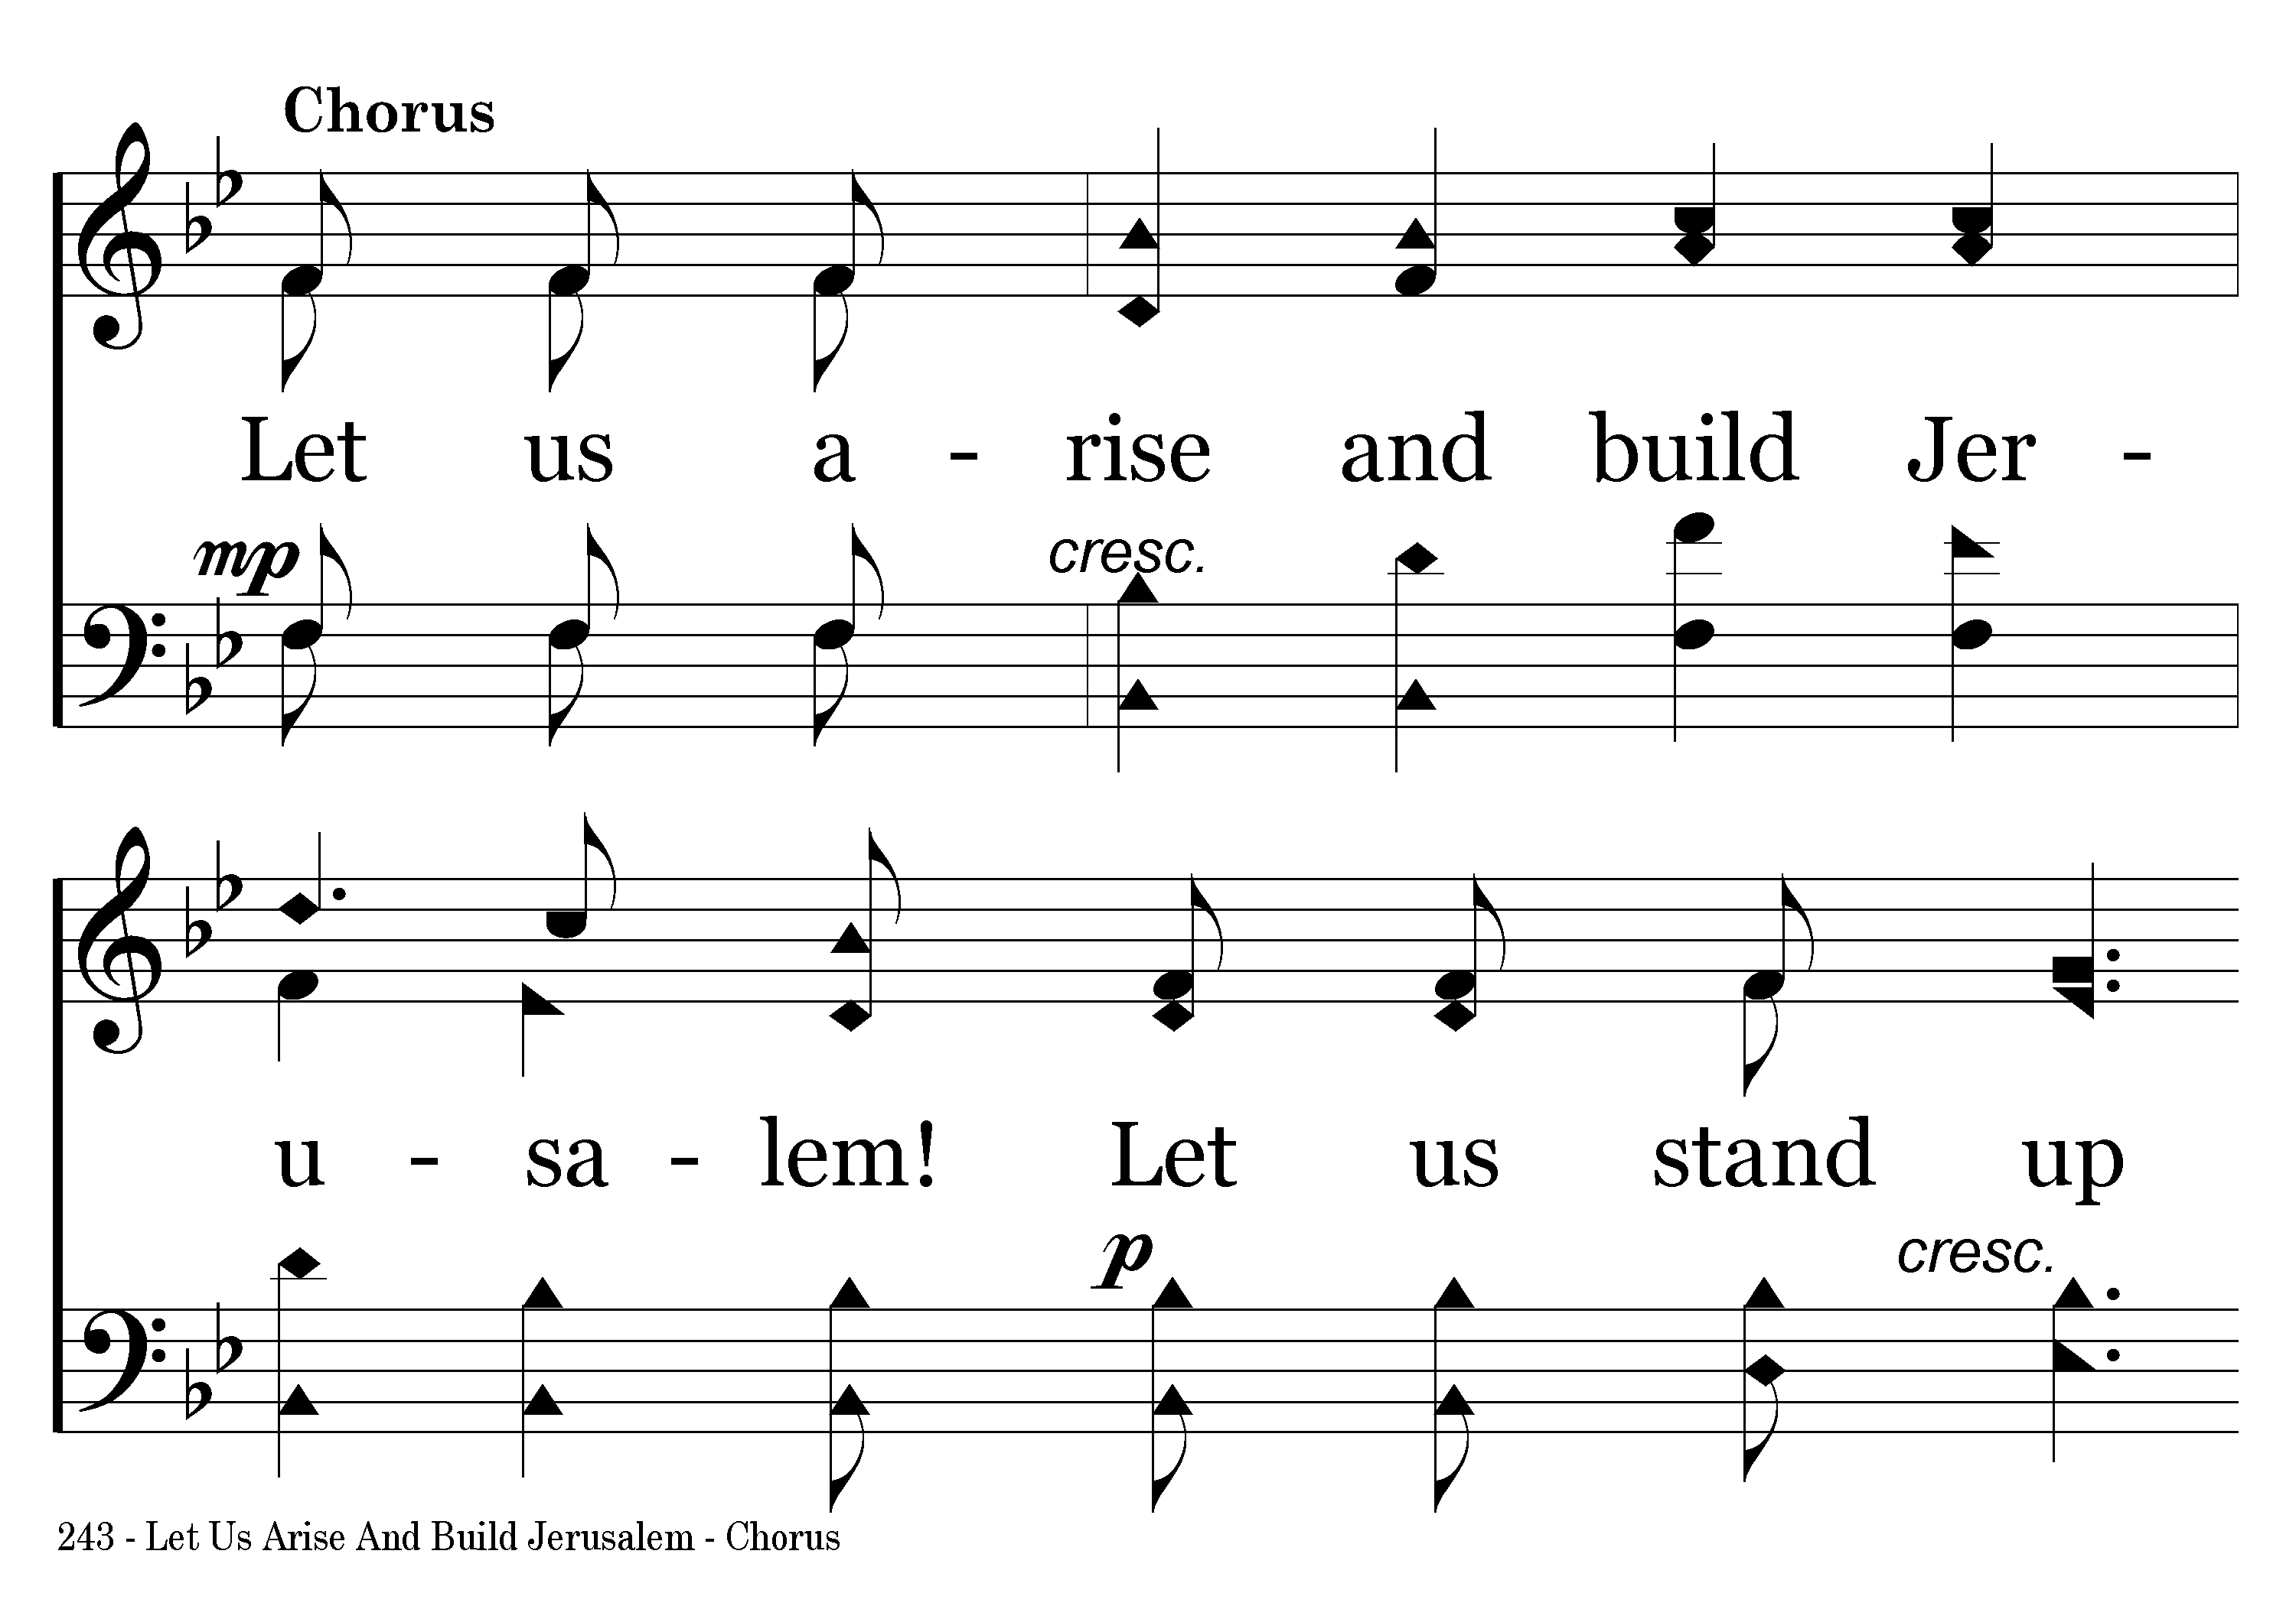
243 - Let Us Arise And Build Jerusalem - C.1

Slide 8
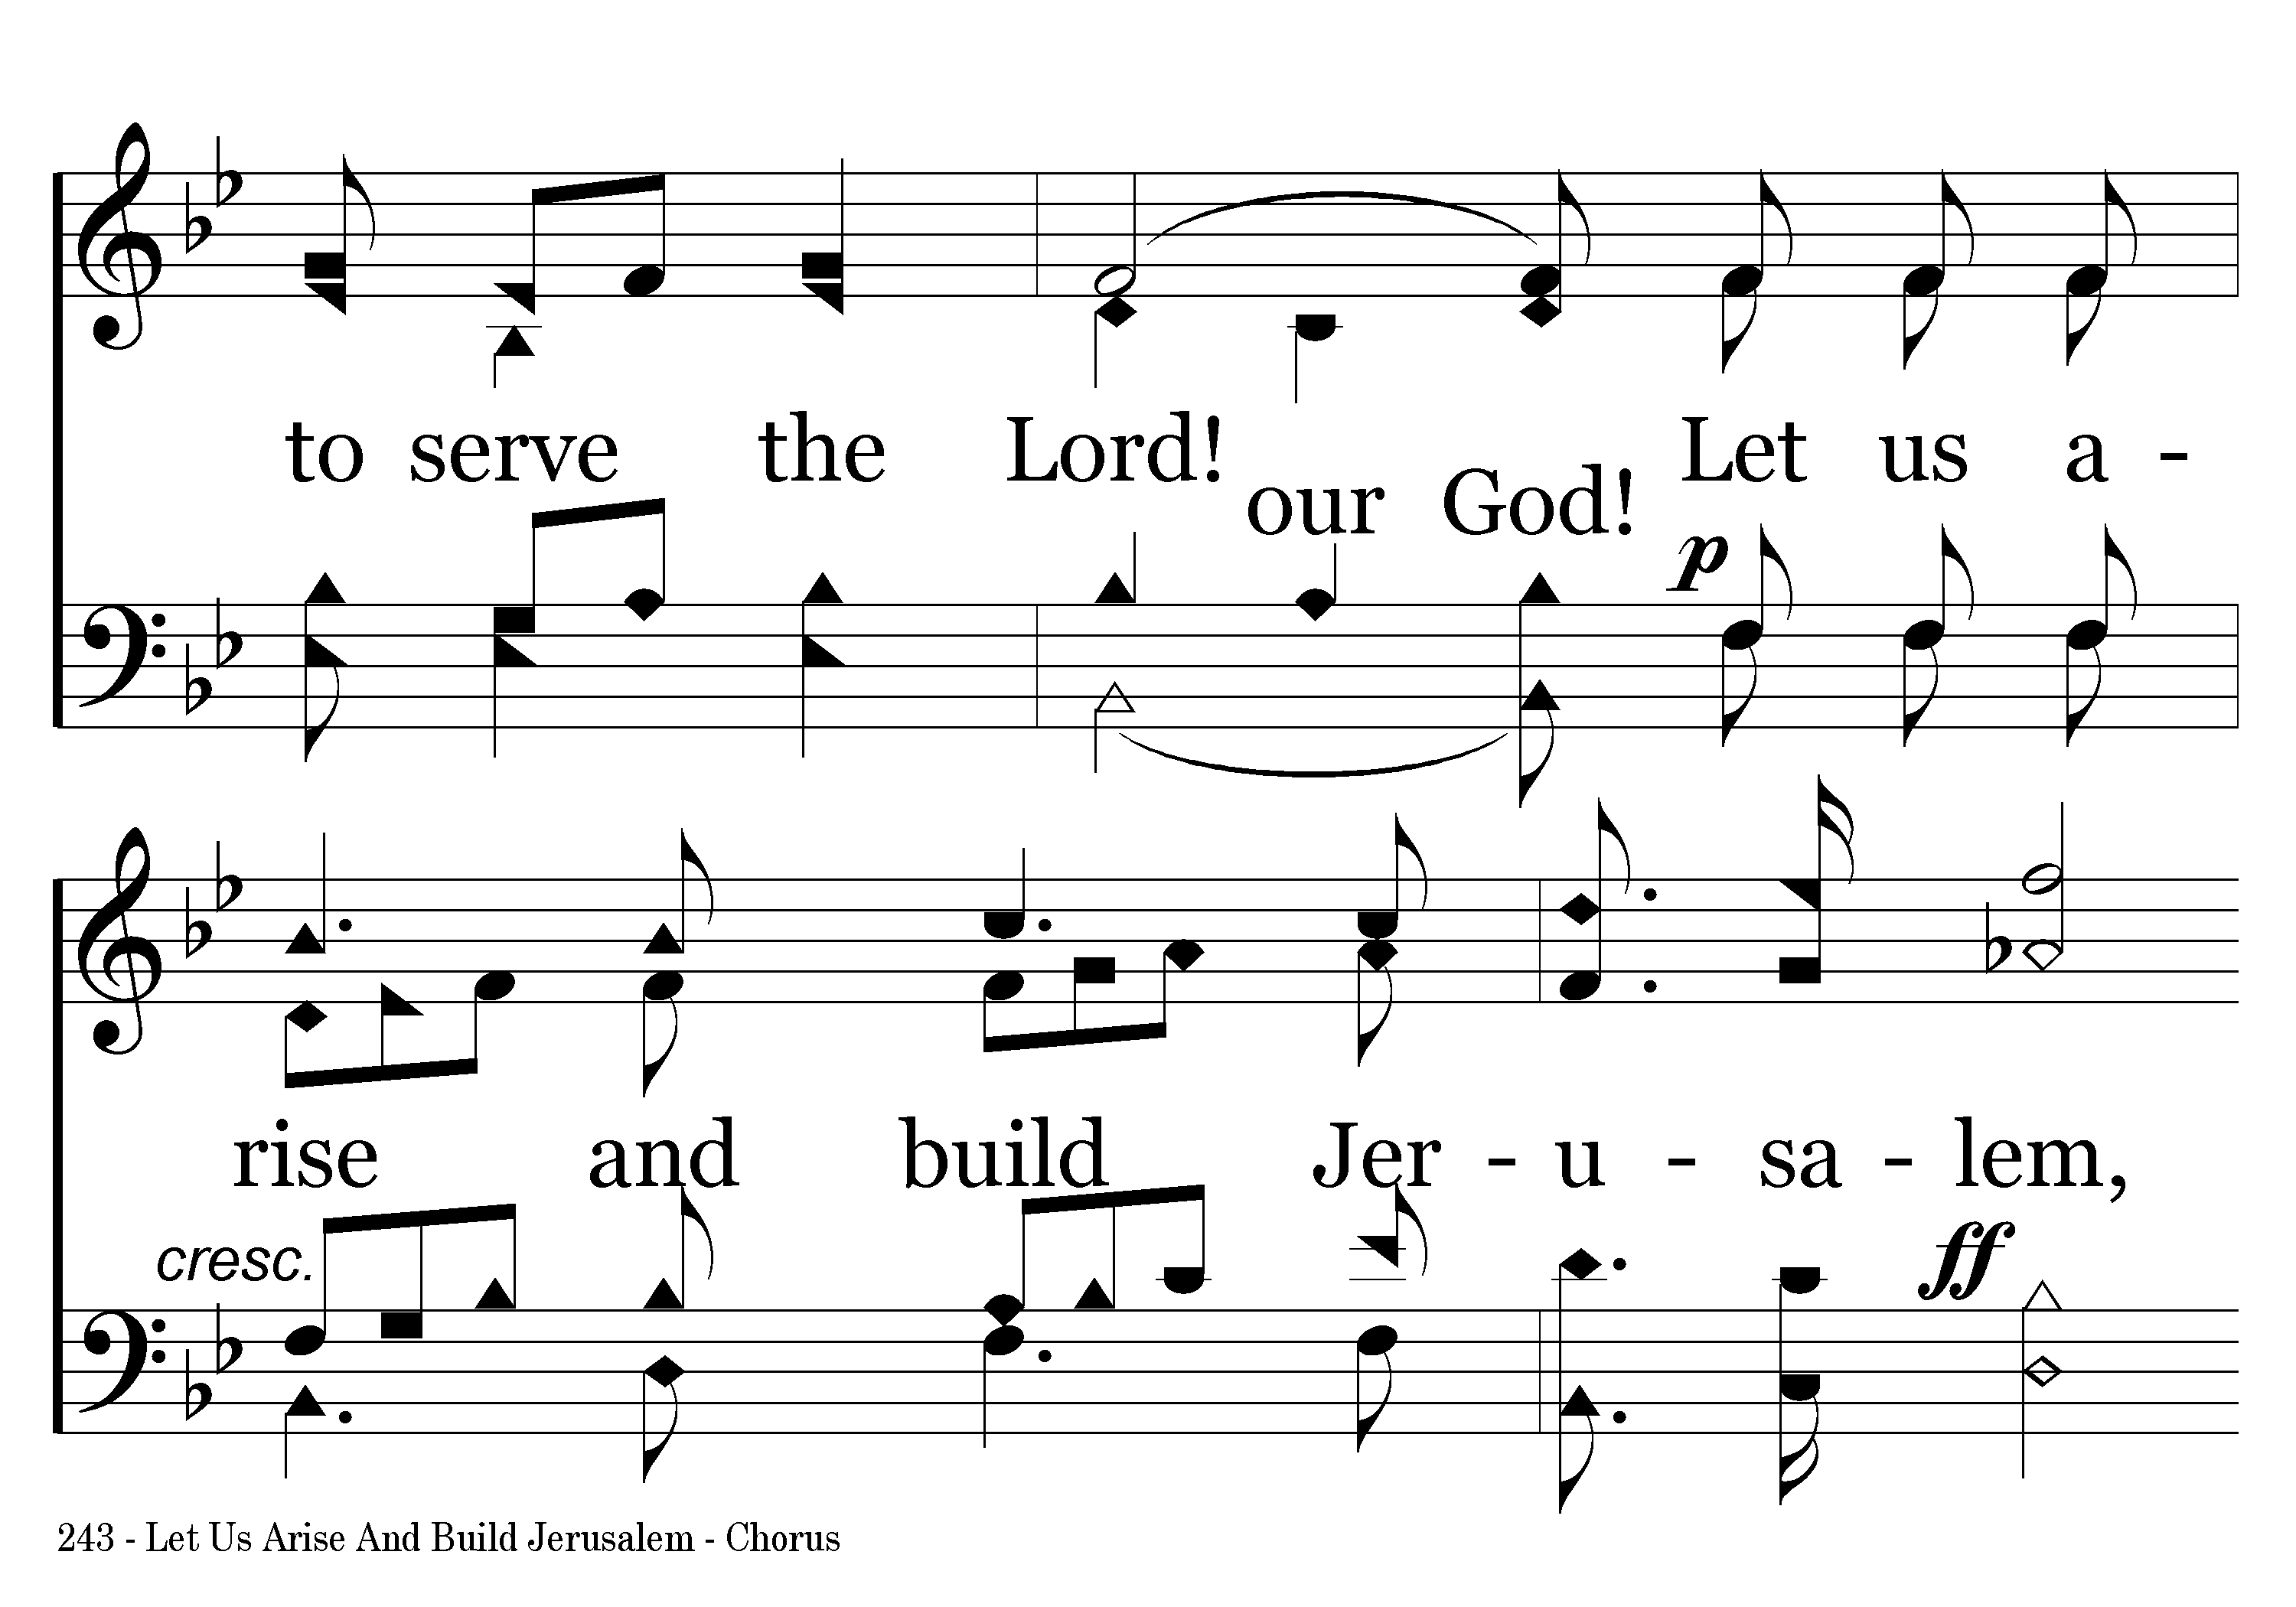
243 - Let Us Arise And Build Jerusalem - C.2

Slide 9
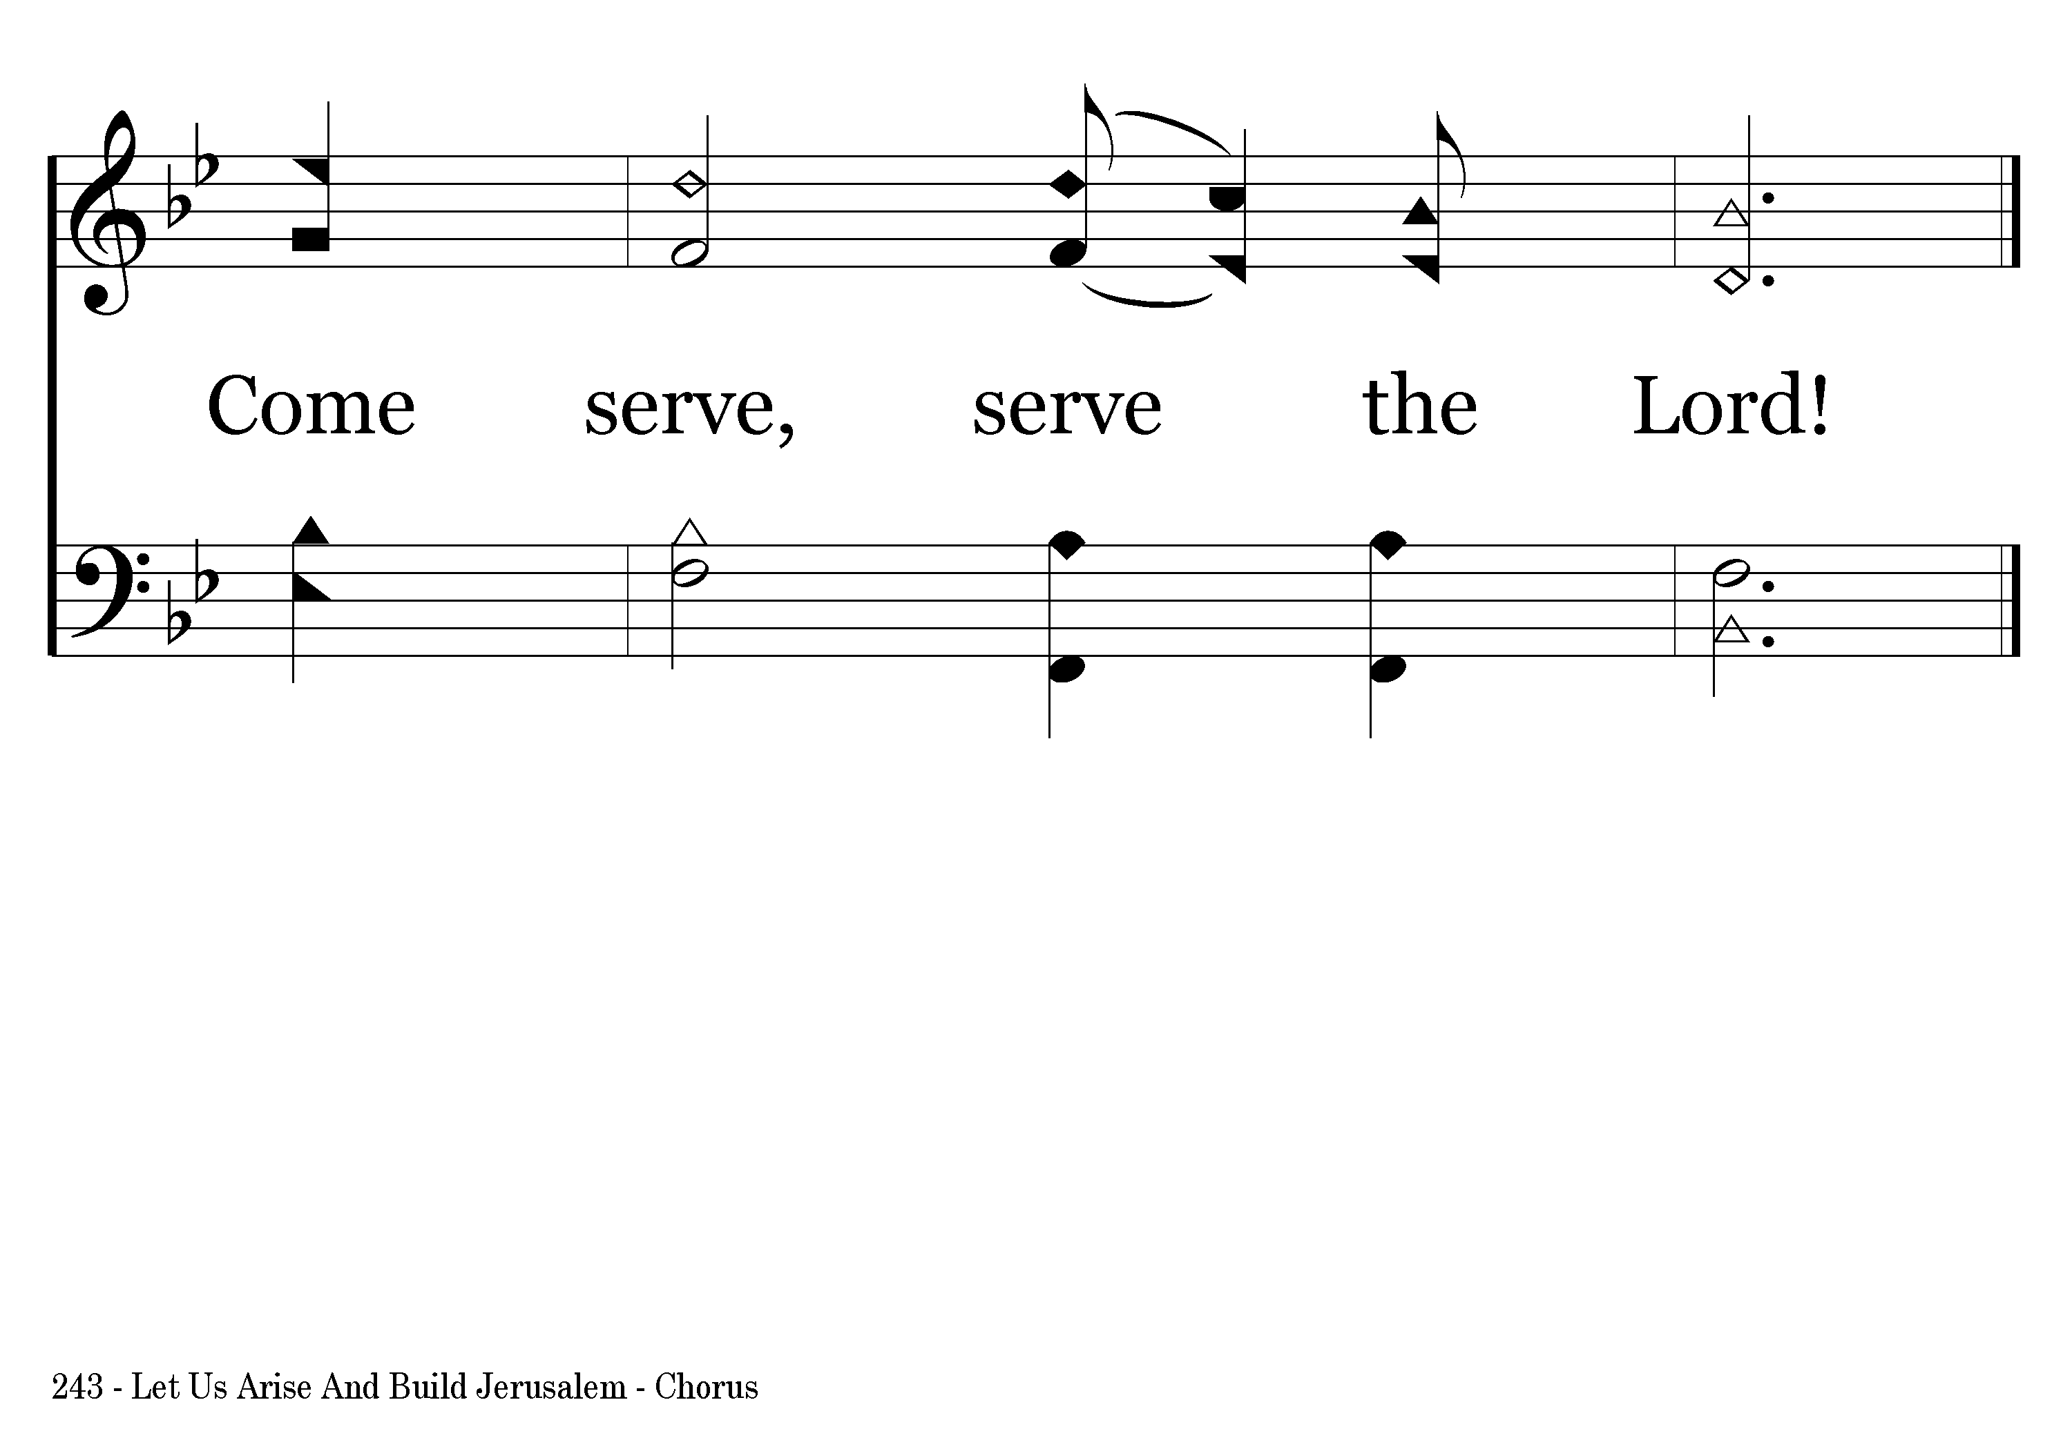
243 - Let Us Arise And Build Jerusalem - C.3
End of Verse 1

Slide 10
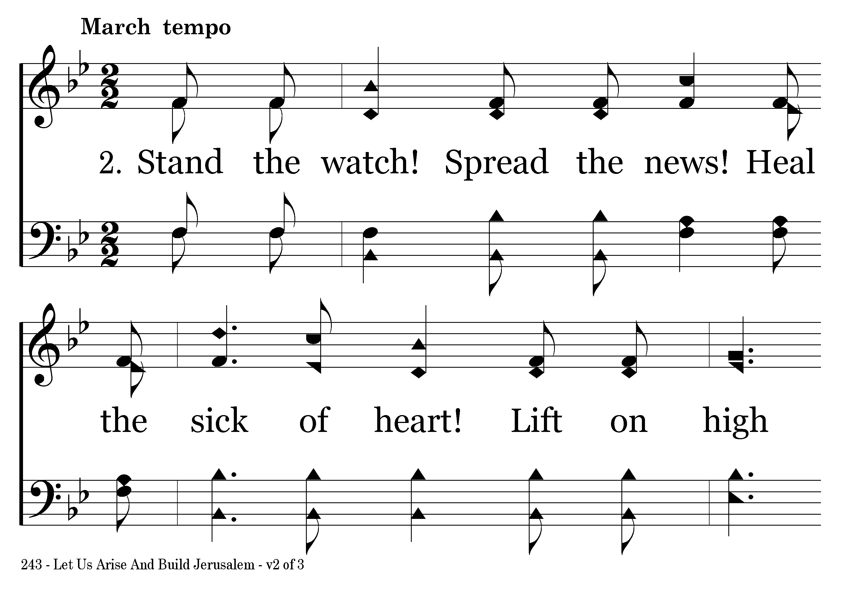
243 - Let Us Arise And Build Jerusalem - 2.1

Slide 11
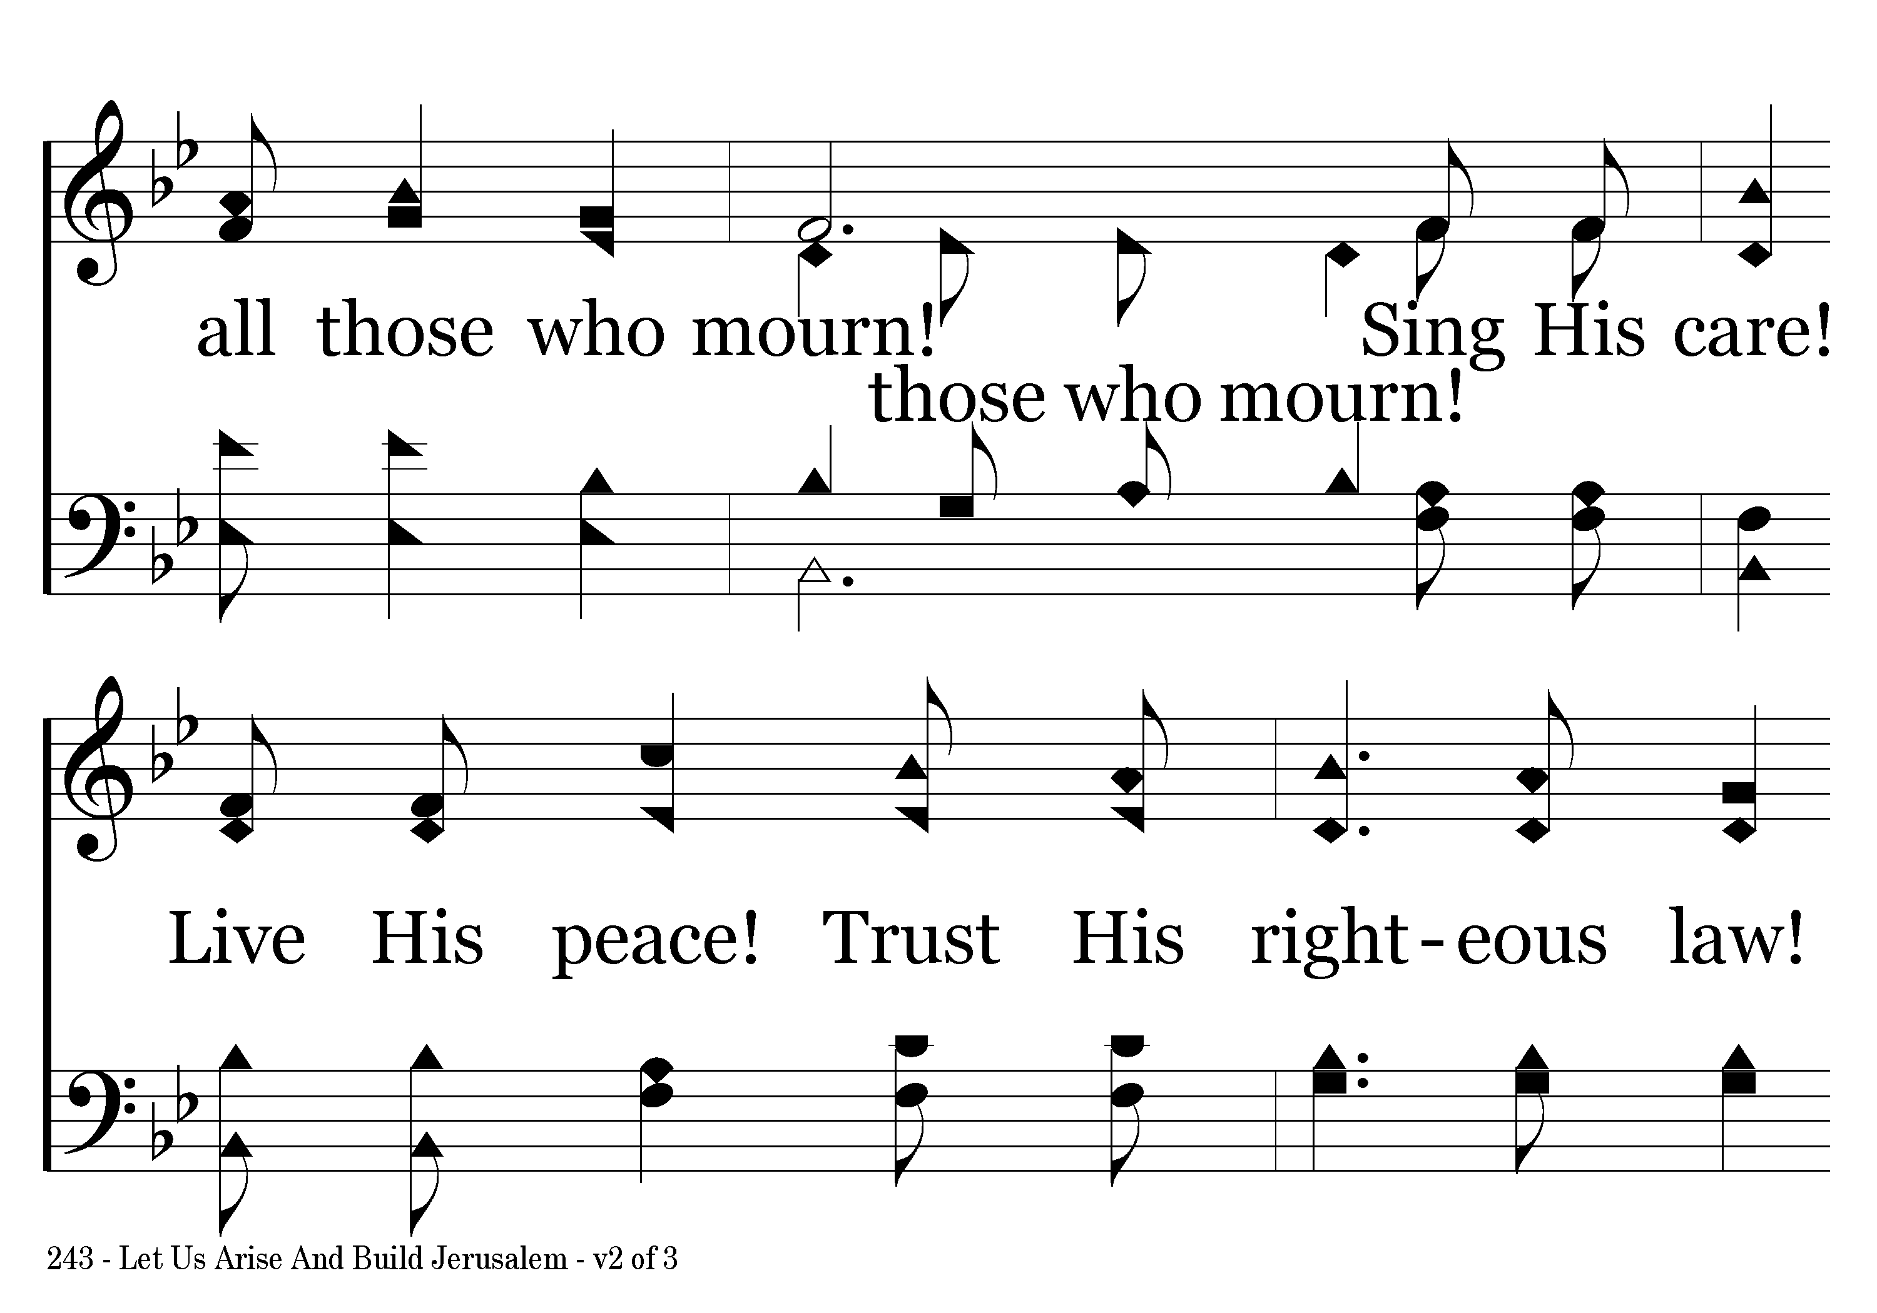
243 - Let Us Arise And Build Jerusalem - 2.2

Slide 12
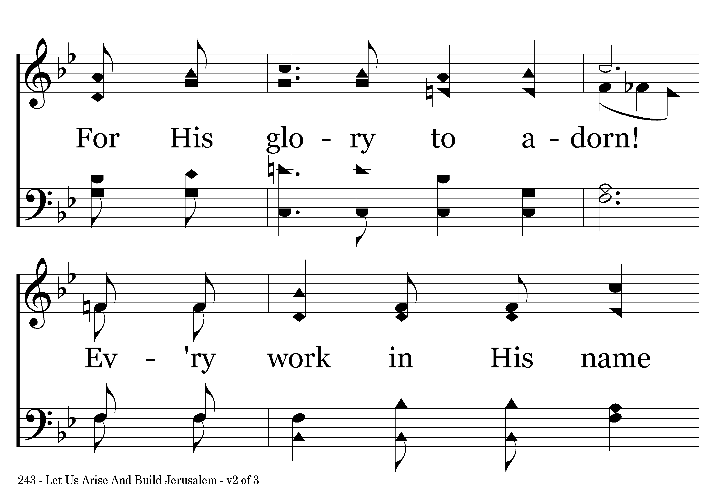
243 - Let Us Arise And Build Jerusalem - 2.3

Slide 13
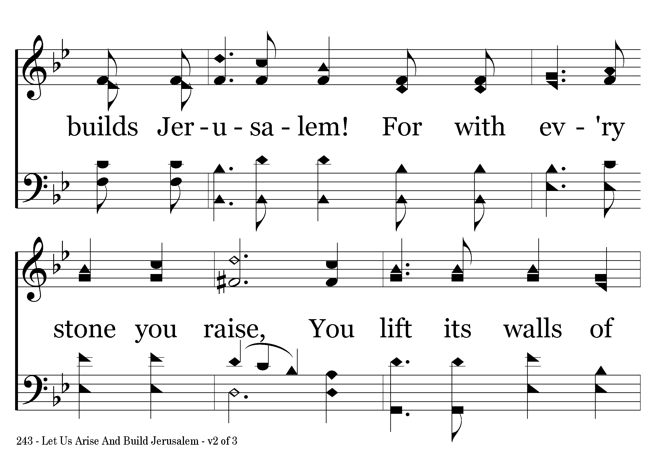
243 - Let Us Arise And Build Jerusalem - 2.4

Slide 14
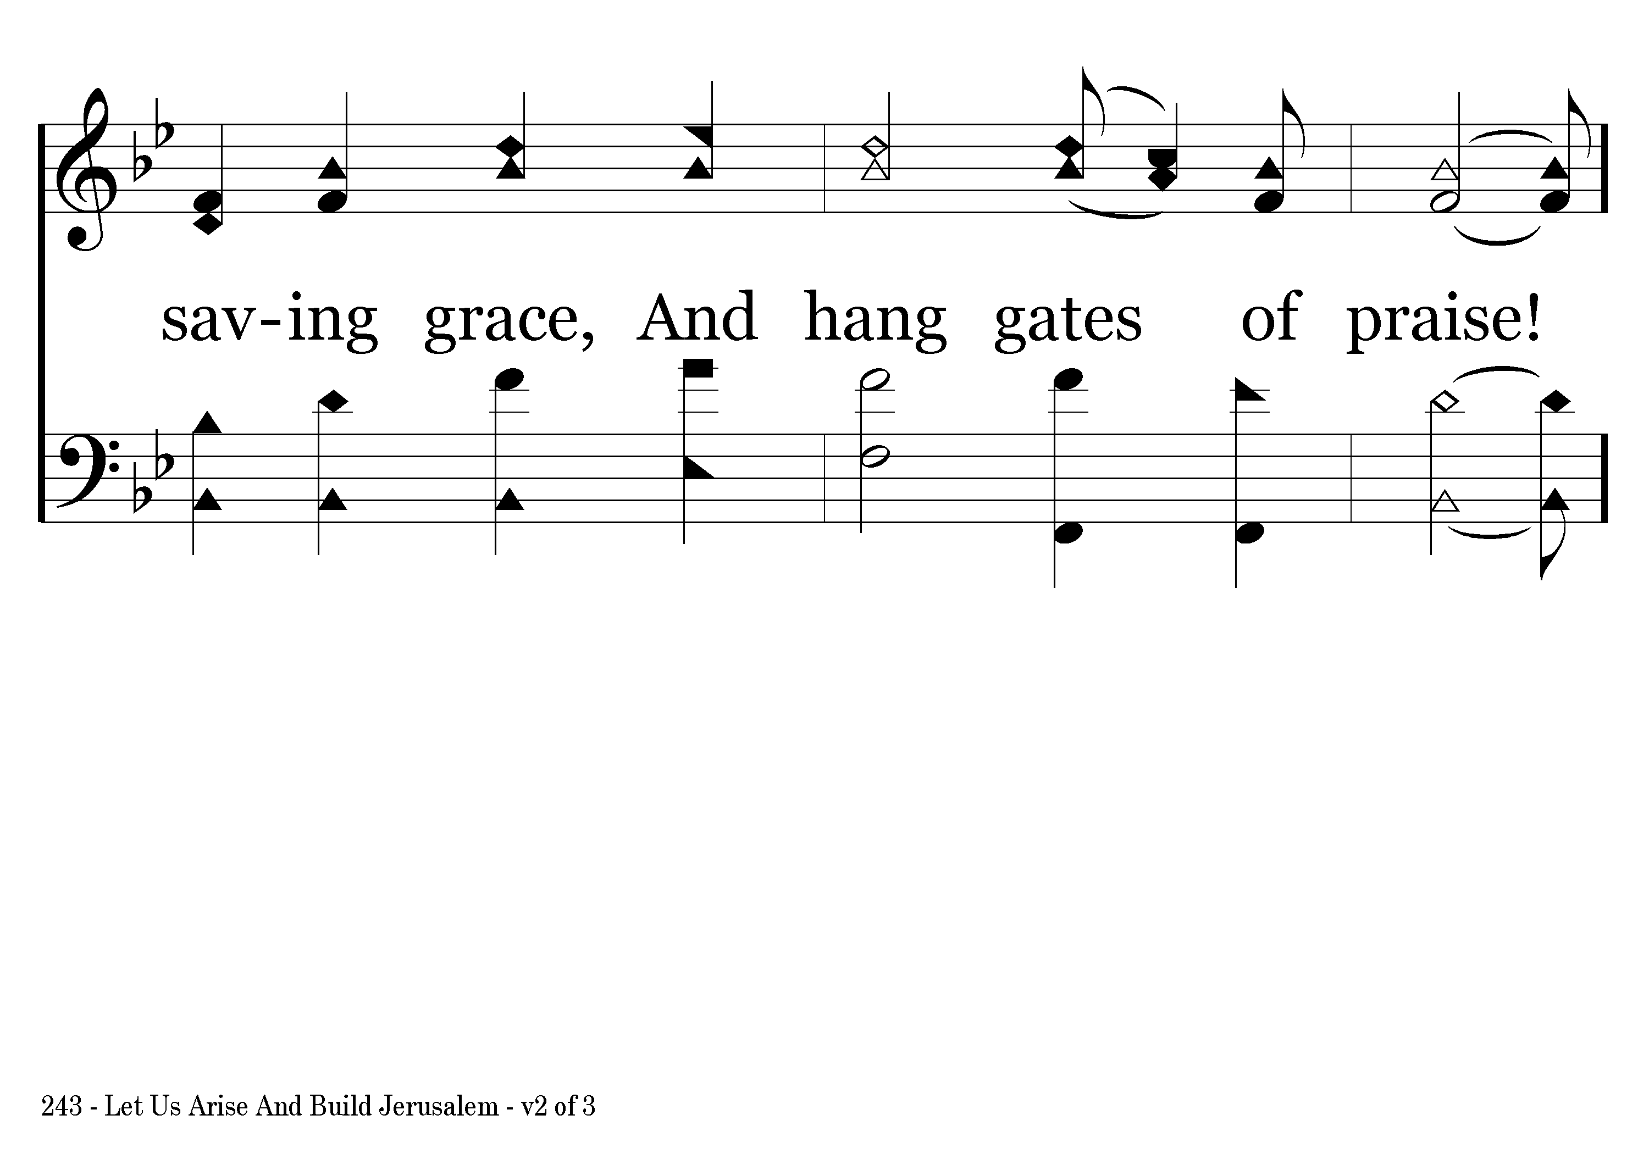
243 - Let Us Arise And Build Jerusalem - 2.5

Slide 15
243 - Let Us Arise And Build Jerusalem - C.1

Slide 16
243 - Let Us Arise And Build Jerusalem - C.2

Slide 17
243 - Let Us Arise And Build Jerusalem - C.3
End of Verse 2

Slide 18
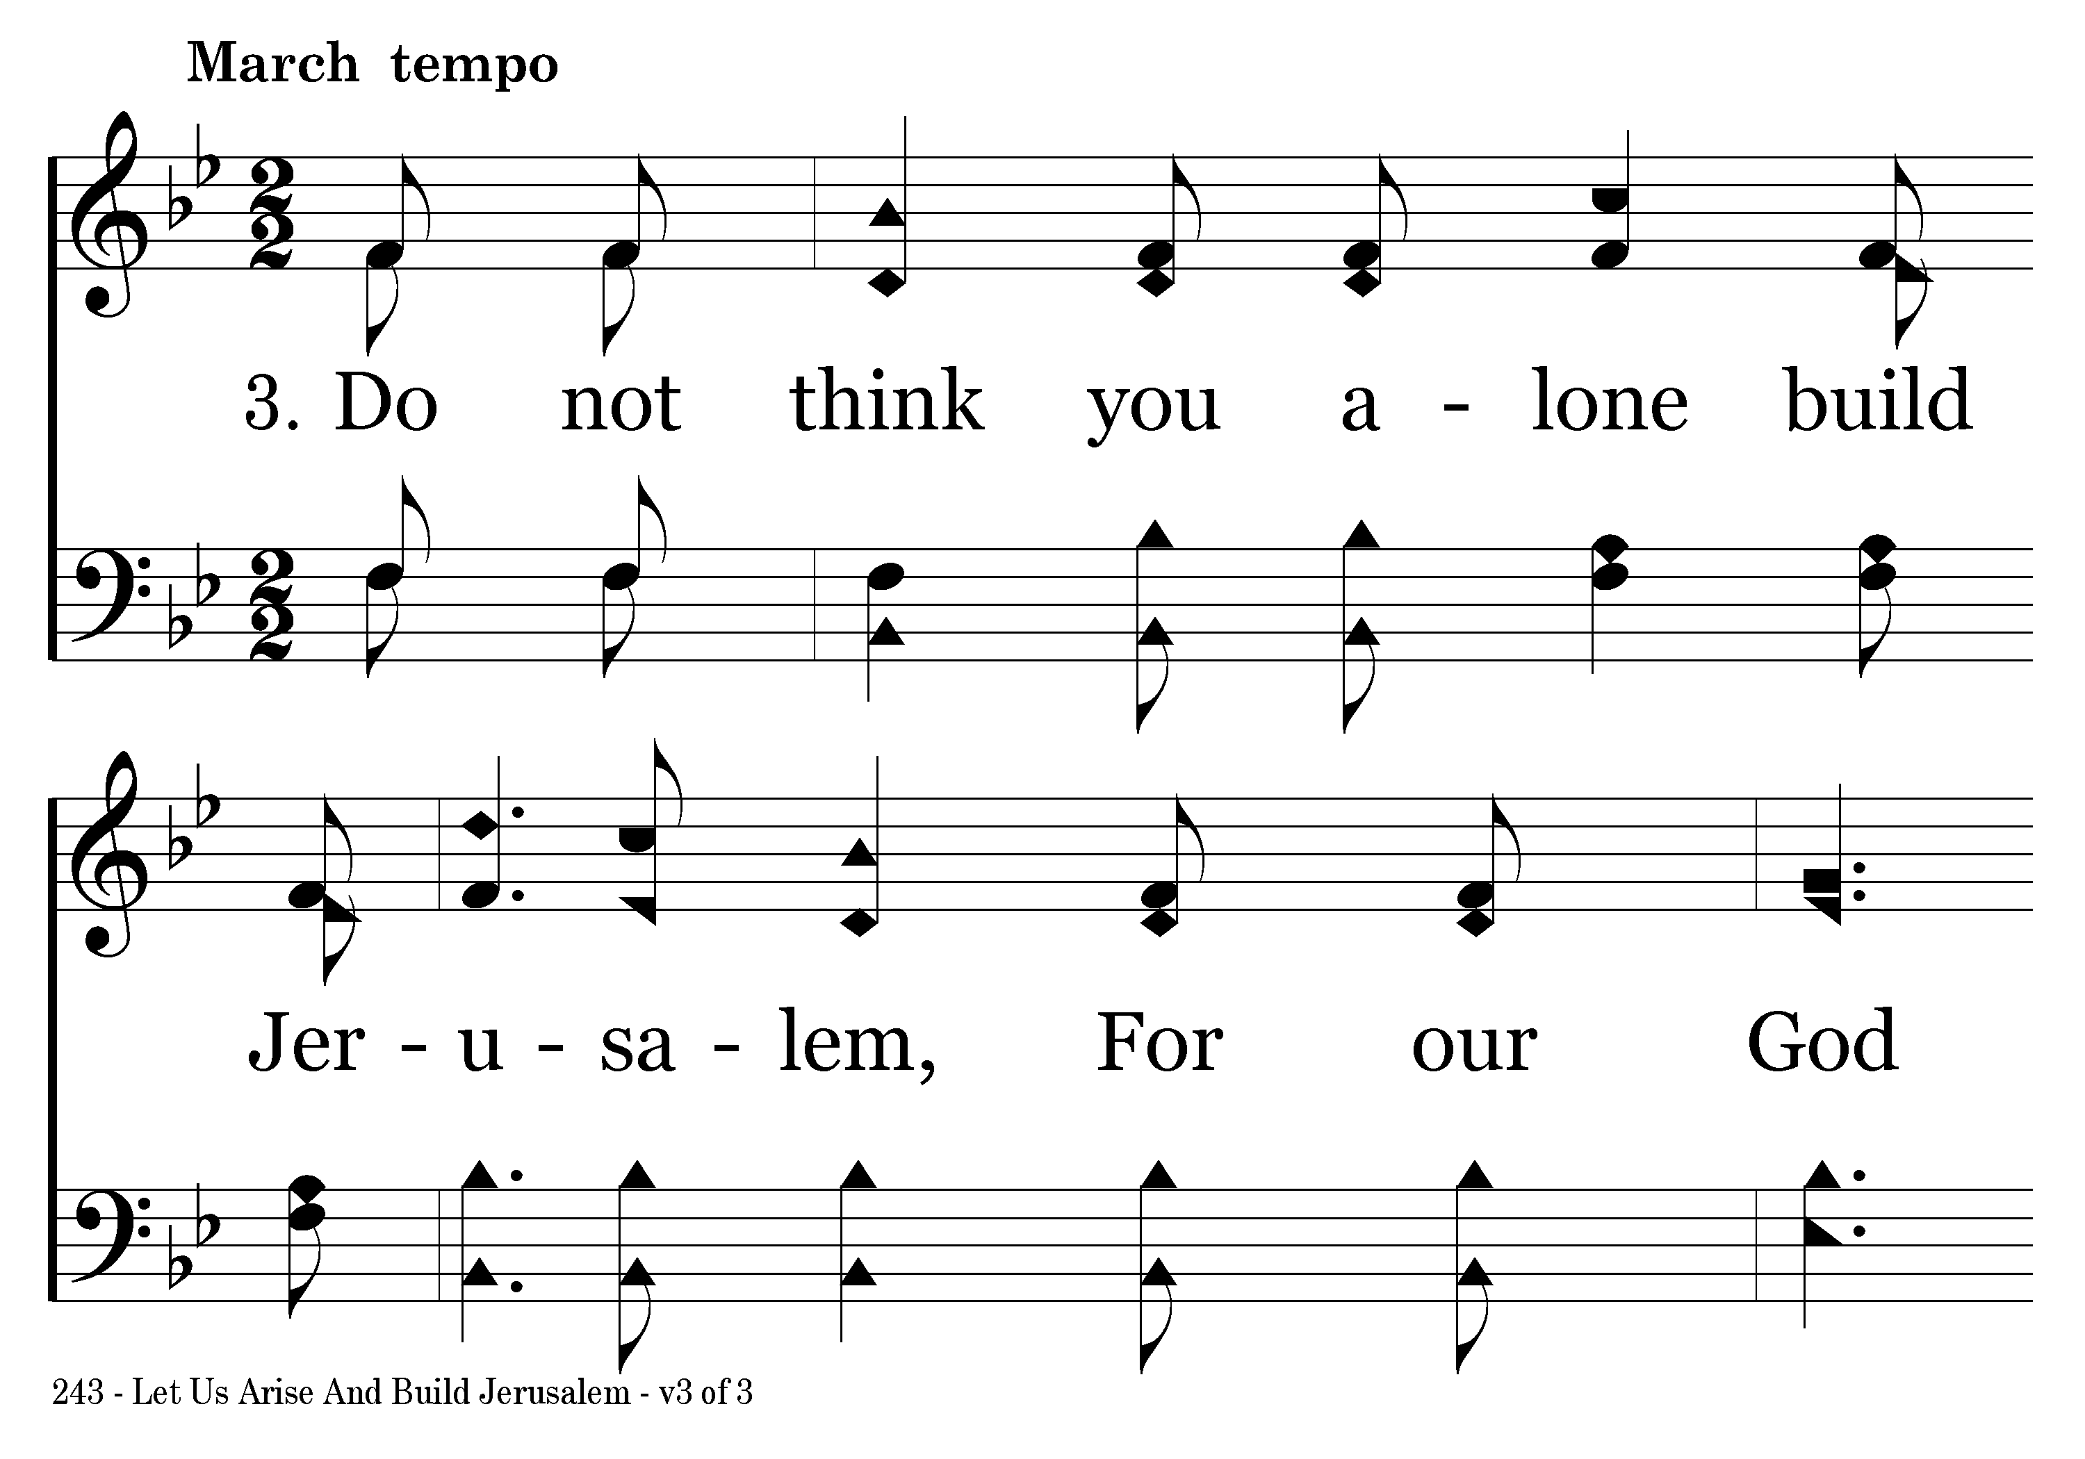
243 - Let Us Arise And Build Jerusalem - 3.1

Slide 19
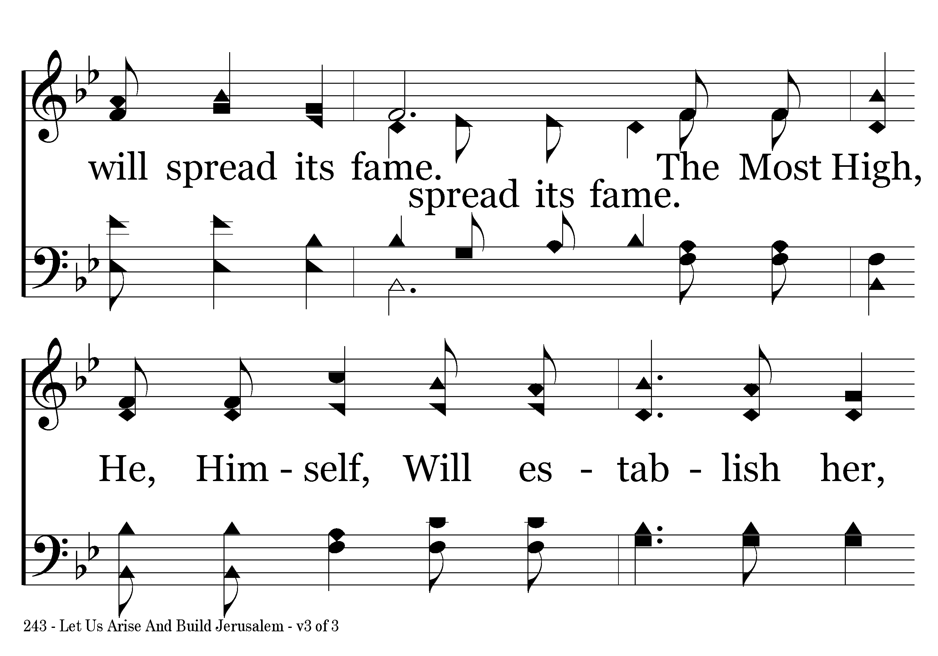
243 - Let Us Arise And Build Jerusalem - 3.2

Slide 20
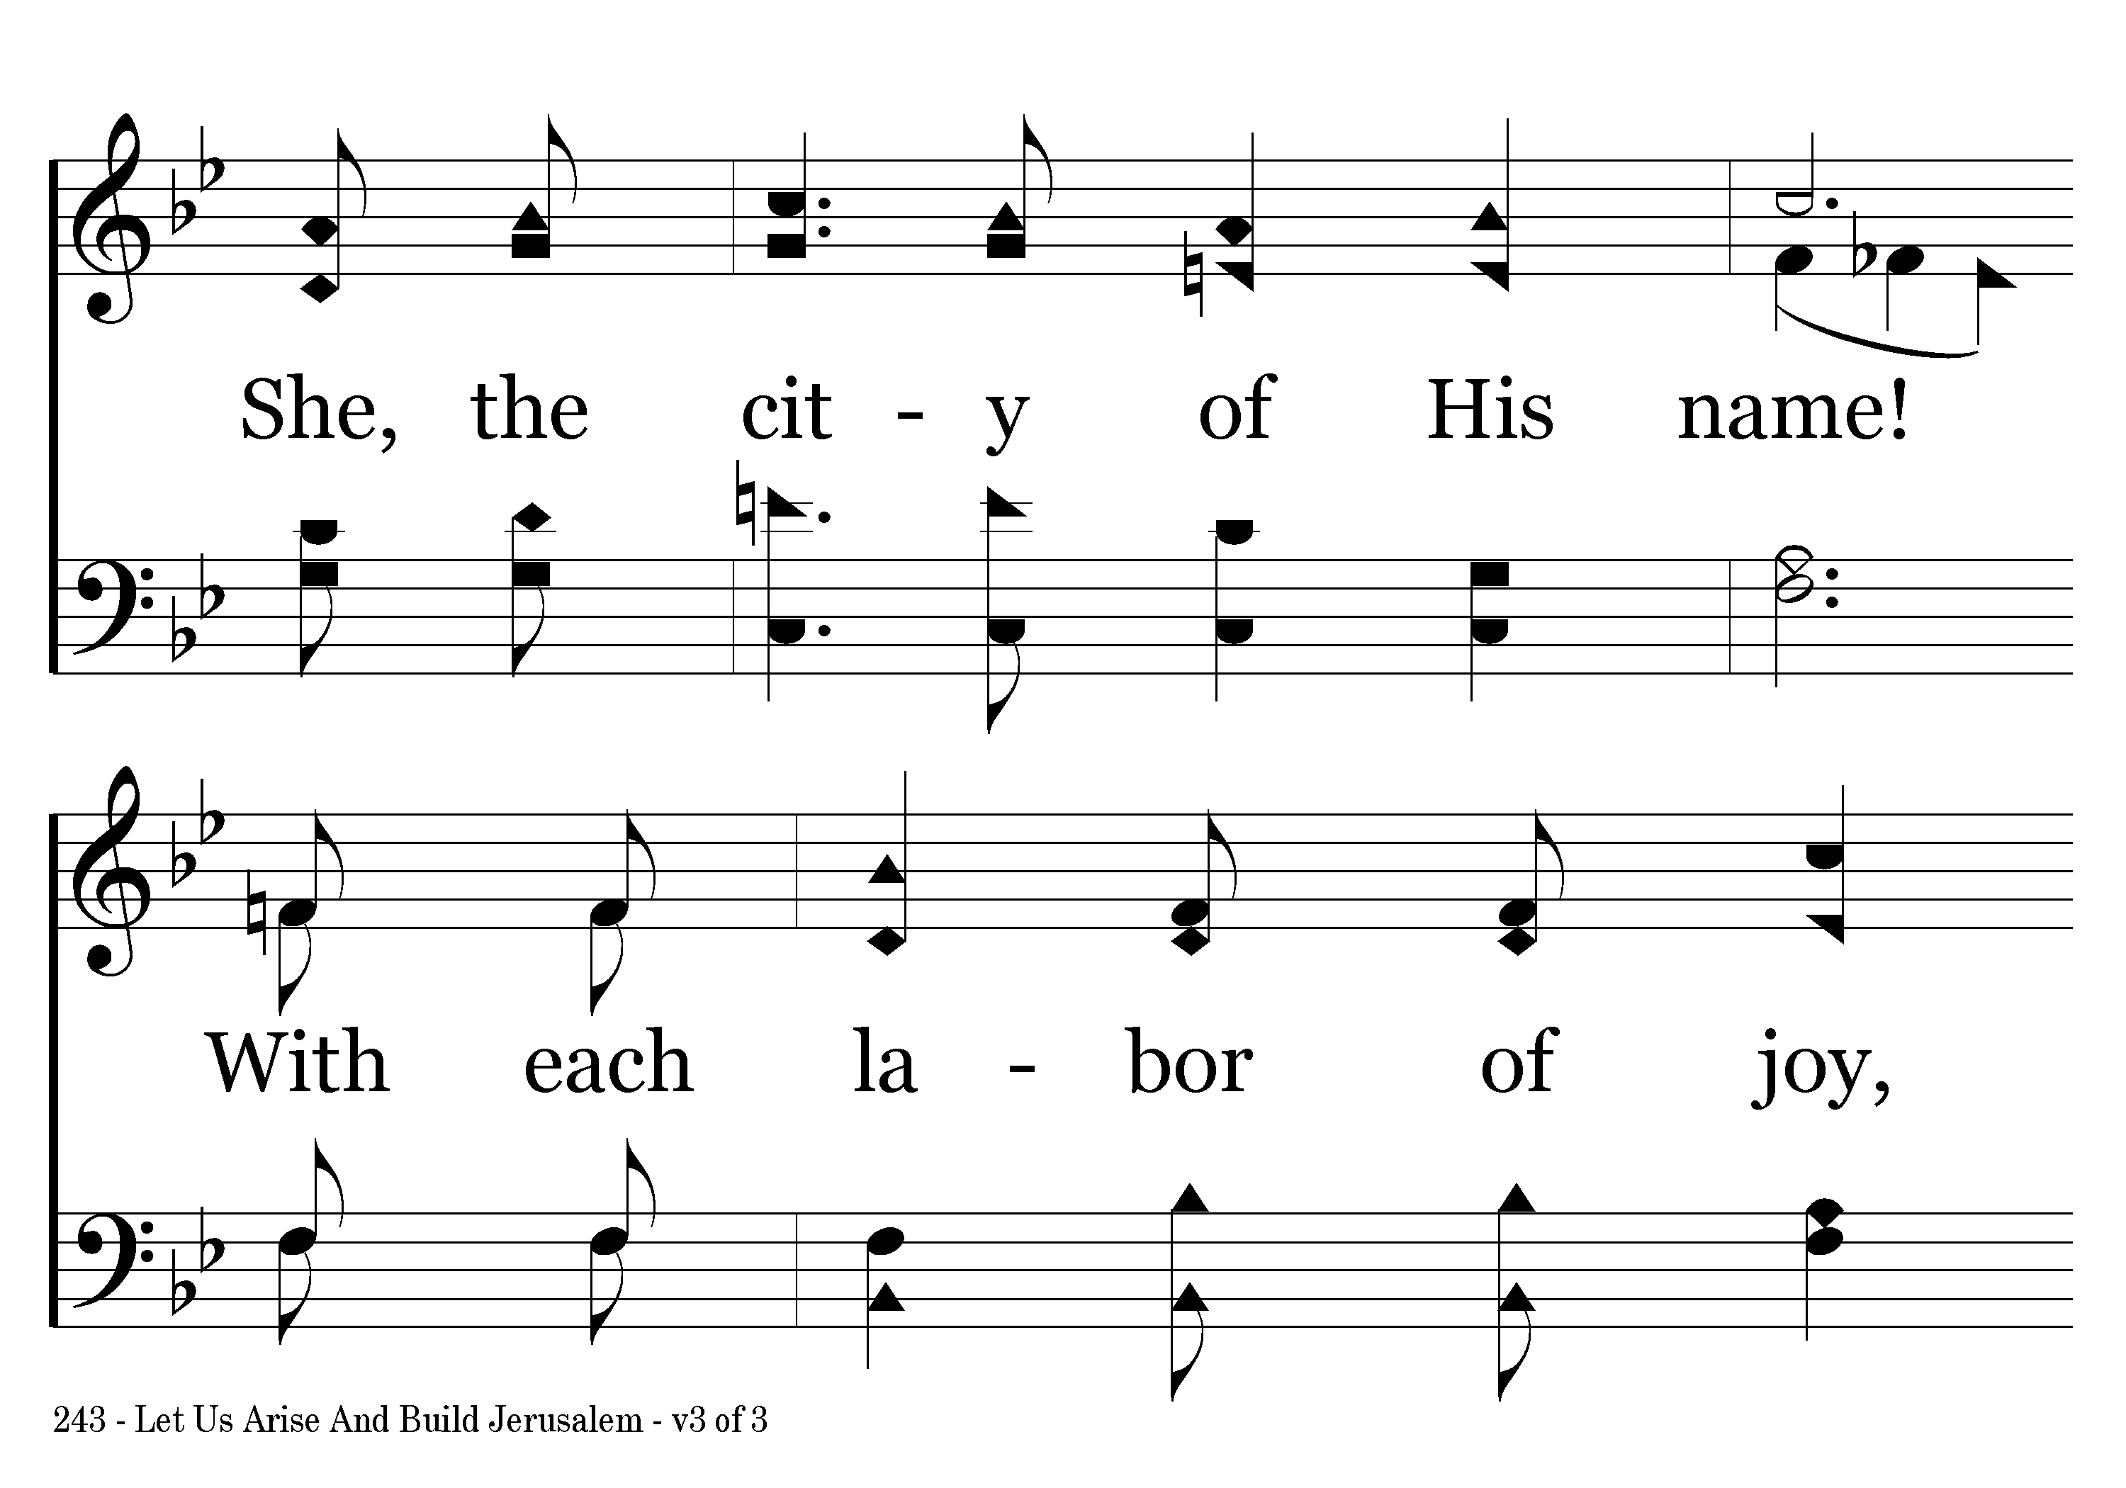
243 - Let Us Arise And Build Jerusalem - 3.3

Slide 21
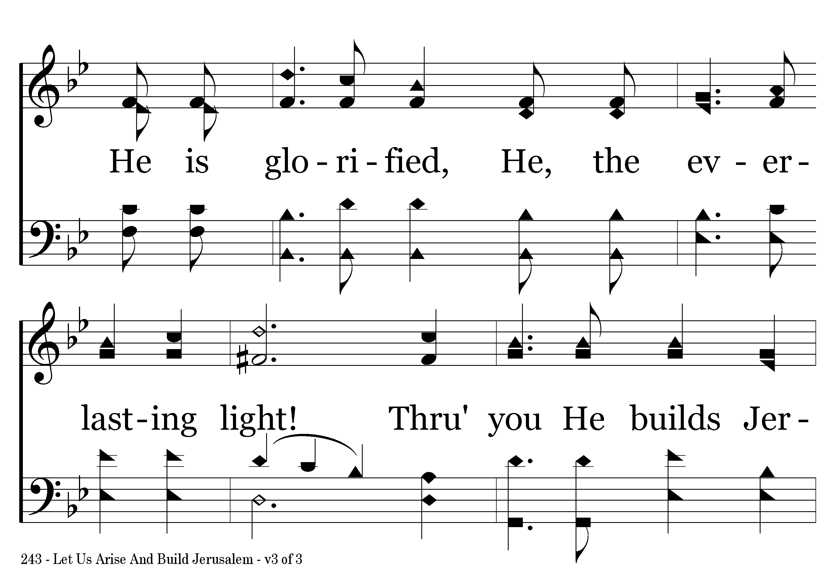
243 - Let Us Arise And Build Jerusalem - 3.4

Slide 22

243 - Let Us Arise And Build Jerusalem - 3.5

Slide 23
243 - Let Us Arise And Build Jerusalem - C.1

Slide 24
243 - Let Us Arise And Build Jerusalem - C.2

Slide 25
243 - Let Us Arise And Build Jerusalem - C.3
End of Song

